Slide 1

BU18 : GPU Comparison
2023. 08.18

Slide 2





CONTENTS
01
Market Opportunity – GPU for Gaming
Introduce and compare NVIDIA / AMD GPU
NVIDIA / AMD Software support
Compare Top Benchmarking Software
Which GPU is the most cost-effective
02
03
04
05

Slide 3
1
Market Opportunity – GPU for Gaming

Slide 4
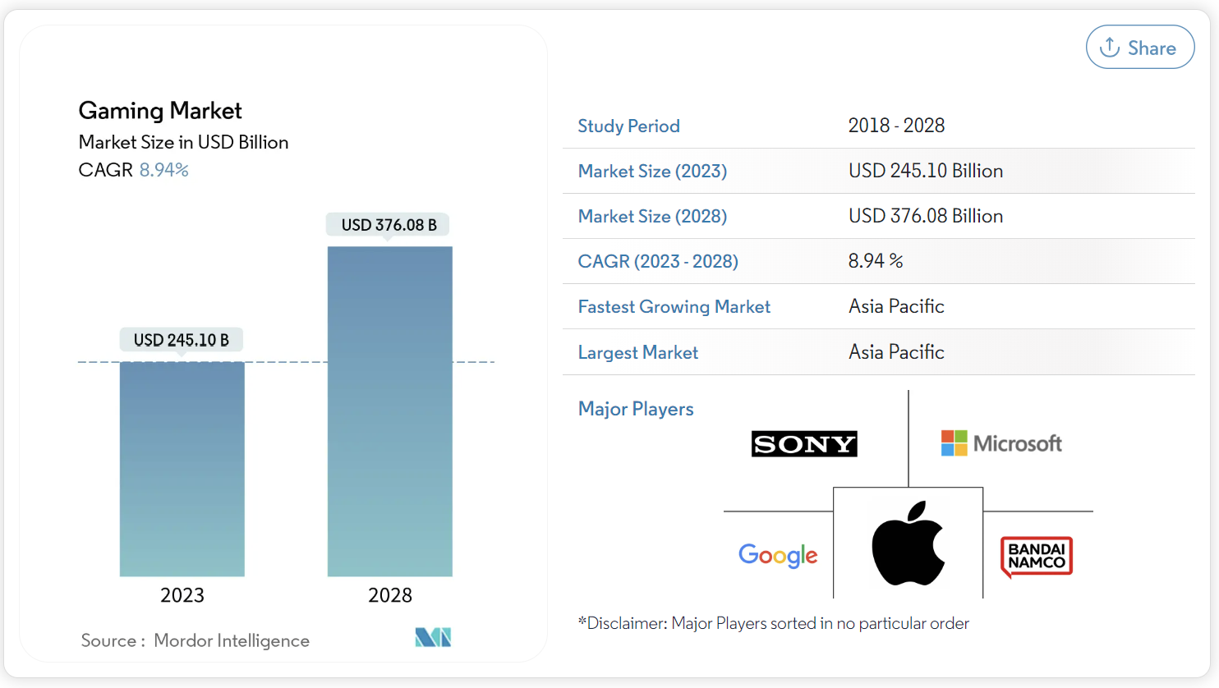
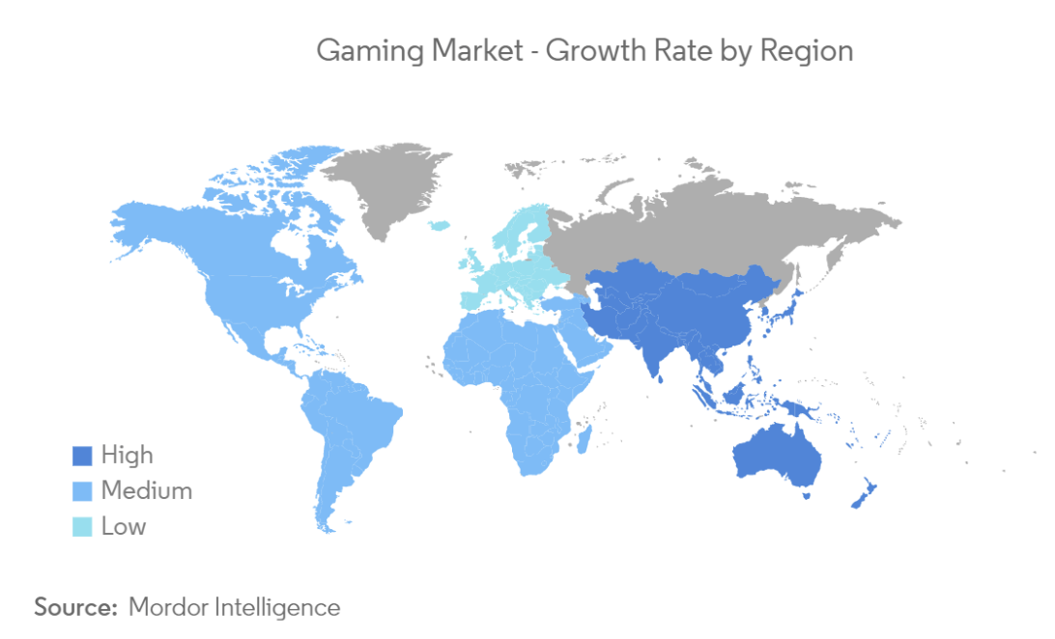
Market Opportunity – GPU for Gaming
The Gaming Market size is estimated at USD 245.10 billion in 2023, and is expected to reach USD 376.08 billion by 2028, growing at a CAGR of 8.94% during the forecast period (2023-2028).
Gaming Market Size
Gaming Market Growth Rate by Region
Factors such as China, Japan, and South Korea among the top 10 games spenders globally, the region’s hotbed for mobile gaming, and growing gamer population will drive significant growth in Asia Pacific over the forecast period.
The integration of Software and Hardware in the game market has become a trend.
Notes:
遊戲市場分析
遊戲市場規模預計到 2023 年為 2451 億美元，預計到 2028 年將達到 3760.8 億美元，在預測期內（2023-2028 年）複合年增長率為 8.94%。
中國、日本和韓國躋身全球十大遊戲消費國、該地區移動遊戲的溫床以及不斷增長的遊戲玩家人口等因素將推動亞太地區在預測期內顯著增長。
全球娛樂及媒體產業在疫情嚴峻的 2020 到 2021 間漲幅高達 10.4%，2022 年持續成長，年增 7.3％，預計 2021 至 2026 年間，將以 4.6% 的年複合成長率擴大至 2.9 兆美元。
黃智仁將此新生代群體稱作「Gaming 世代」，他解釋道，過去會將遊戲玩家細分為「喜歡遊戲內容」及「喜歡硬體設備」兩大類型，但新的 Gaming 世代不只喜歡玩遊戲，同時也研究硬體設備，「他們為了玩一個遊戲，會去選適合的硬體，相互搭配呈現自我風格。」這群新世代的玩家，更在乎遊戲內容和硬體相互搭配下的整體體驗，而非單純遊戲畫風、電腦螢幕反應時間等個別要素。
正因如此，遊戲市場也出現「軟硬整合」的趨勢，如華碩就推出電競手機「ROG Phone」系列。黃智仁指出，品牌端透過接觸大量的遊戲發行商，甚至在遊戲開發階段就讓廠商以自家手機為開發環境，測試其效能、呈現等等，「這樣硬體產品推出的時候，就可以確保哪些遊戲可以很順利的在我的 device（手機）上有極佳的遊戲體驗。」

Slide 5
2
Introduce and compare NVIDIA / AMD GPU

Slide 6
Comparsion – NVIDIA RTX series
GeForce GPU | GeForce RTX 4090 | GeForce RTX 3080 | GeForce RTX 2080 | GeForce GTX 1660
GPU Engine Specification
NVIDIA ^{CUDA®} Cores | 16384 | 8960 / 8704 | 2944 | 1408
Boost Clock(GHz) | 2.52 | 1.71 | 1.8 | 1.78
Basic Clock(GHz) | 2.23 | 1.26 / 1.44 | 1.52 | 1.53
Graphics Processor
Launch Price | 1,599 USD | 699 USD | 699 USD | 219 USD
Release Date | 2022/09/20 | 2020/09/01 | 2018/09/20 | 2019/03/14
Architecture | Ada Lovelace | Ampere | Turing | Turing
Chip factory | TSMC 4 nm | TSMC 8 nm | TSMC 12 nm | TSMC 12 nm
Transistor count | 76.3 billion | 28.3 billion | 13.6 billion | 6.6 billion
Chip area | 608mm² | 628mm² | 545mm² | 284mm²
Memory Specification
Standard Memory Settings | 24 GB GDDR6X | 12GB GDDR6X / 10GB GDDR6X | 8GB GDDR5 | 6GB GDDR5
Memory Interface Bandwidth | 384 bits | 384 bit / 320 bit | 256 bits | 192 bits
Theoretical Performance
FP16 Performance | 82.58 TFLOPS | 29.77 TFLOPS | 20.14 TFLOPS | 10.05 TFLOPS
FP32 Performance | 82.58 TFLOPS | 29.77 TFLOPS | 10.07 TFLOPS | 5.027 TFLOPS
FP64 Performance | 1290 GFLOPS | 465.1 GFLOPS | 314.6 GFLOPS | 157.1 GFLOPS
Board Design
Power consumption | 450W | 320W | 215W | 120W
Power interface | 1x 16-pin | 1x 12-pin | 1x 6-pin + 1x 8-pin | 1x 8-pin

Slide 7
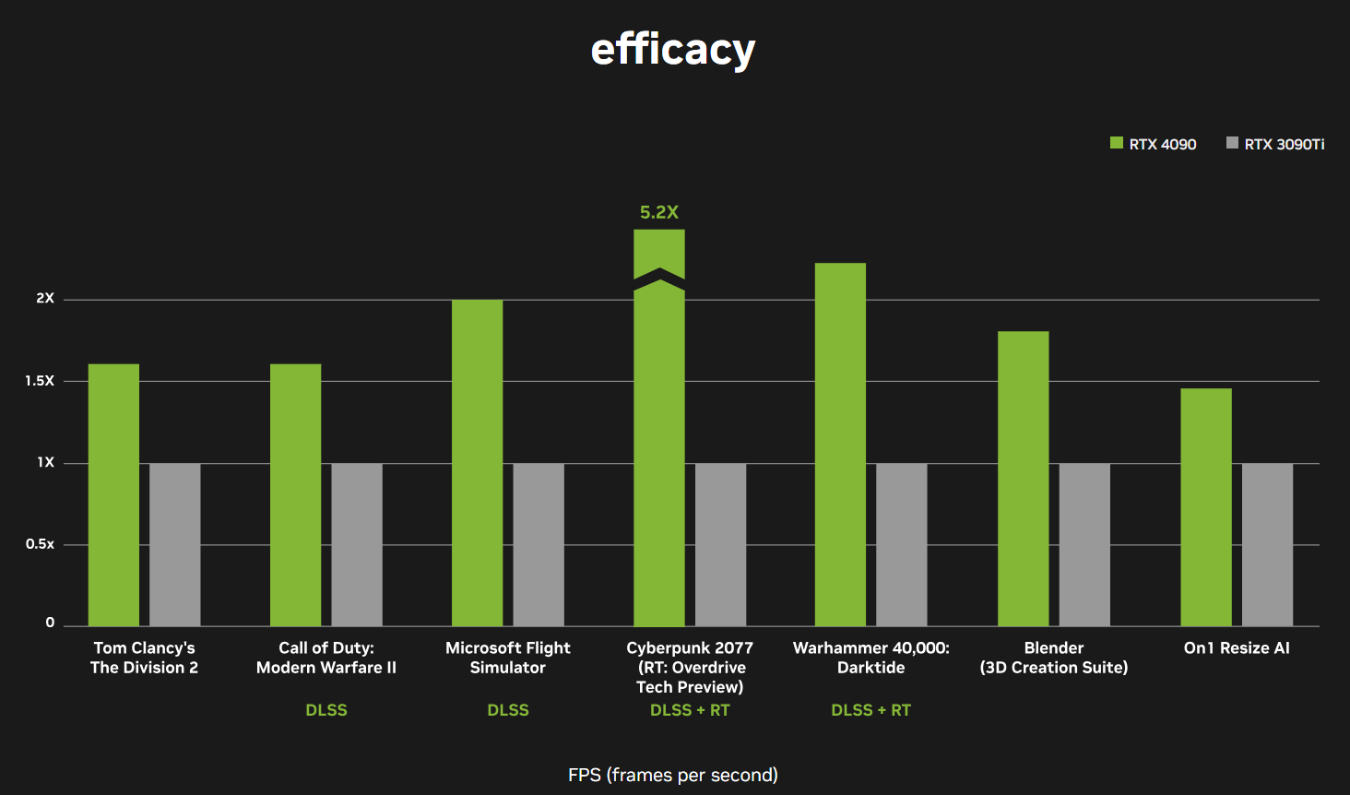
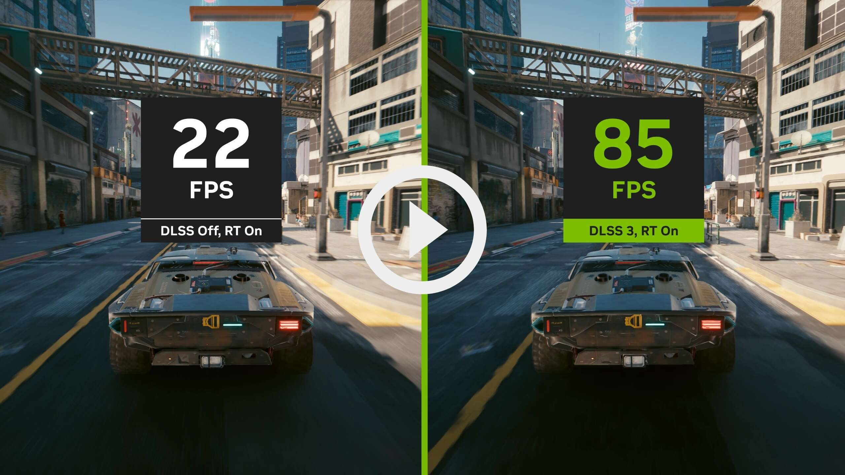
NVIDIA RTX 4090 Pros and Cons
NVIDIA GeForce RTX 4090 Advantages
Smooth Gaming Experience: Provides an immersive gaming experience without experiencing lag or slowdowns.
4K UHD Resolution Support: Enables real-time ray tracing effects, adding stunning realism to modern games.
AI Accelerated Performance: NVIDIA DLSS 3
NVIDIA GeForce RTX 4090 Disadvantages
Expensive: The average PC user doesn't need these graphics processors.
Power Consumption: They require a powerful power source or a durable battery for stable operation.
Compatibility issues: Not all games in the GeForce RTX series support its features and technologies. Some PC games may have limited ray tracing implementations or may not support deep learning super sampling.
Notes:
NVIDIA GeForce RTX 4090 在全新核心架構與及各種升級的技術之下，無論是遊戲效能以至專業領域的渲染層面上，都比起 RTX 30 系列有十分明顯的提升。尤其是針對遊戲效能提升的 DLSS 3，比起 DLSS 2 可進一步提升遊戲的效能，以配合現時開始流行的 4K 遊戲。 在FPS 是「每秒幀數」，影片流暢與清晰程度更好，視覺更貼近生活中肉眼所見。
NVIDIA GeForce RTX 4090 優勢
流暢的遊戲體驗:NVIDIA RTX 4090 擁有先進的圖靈架構和強大的 RT 核心，可提供身臨其境的遊戲體驗，而不會遇到延遲或速度變慢的問題。
4K超高清分辨率支持:可實現實時光線追踪效果，為現代遊戲增添令人驚嘆的真實感。這使得 NVIDIA RTX 4090 成為營造影院感覺的絕佳選擇
安靜運行:該 GPU 的核心採用先進的冷卻技術，可將溫度保持在理想水平，確保即使在峰值性能水平下也能安靜運行。此外，其超低噪音風扇可確保您的遊戲體驗保持愉快，而不會分散背景噪音。
DLSS 3 功能:DLSS 是人工智慧繪圖技術的革命性突破，可大幅提升效能，可運用人工智慧創造額外的高品質畫面。
• 昂貴的選項：較高的價格點來自於針對特定市場領域的先進技術、特性和功能。普通 PC 用戶不需要這些圖形處理器。GTX 和 GT、Intel Iris Xe和Intel Iris Xe Max或中檔 AMD Radeon 選項就足夠了。
• 功耗：這些GPU強大的處理能力意味著它們與中端和入門級GPU相比具有更高的功耗。
兼容性問題： GeForce RTX 系列的另一個缺點是並非所有遊戲都支持其功能和技術。某些 PC 遊戲的光線追踪實現可能有限，或者可能不支持深度學習超級採樣。檢查特定遊戲兼容性和更新以最大限度地提高這些圖形處理器的性能或處理能力和優勢非常重要。
性能有限：強調上述兼容性問題的影響也很重要。如果特定用例或應用程序不支持其功能和技術，RTX 圖形處理器的處理能力將變得毫無用處。這意味著性能提升的程度仍然取決於特定軟件應用程序的支持級別。

Slide 8
Comparsion – AMD Radeon™ RX series
GeForce GPU | Radeon RX 7900 XT | Radeon RX 6900 XT | AMD Radeon RX 5700 XT
GPU Engine Specification
Boost Clock(GHz) | 2.39 | 2.25 | 1.9
Basic Clock(GHz) | 1.50 | 1.8 | 1.6
Graphics Processor
Launch Price | 899 USD | 999 USD | 399 USD
Release Date | 2022/11/03 | 2020/10/28 | 2019/07/07
Architecture | RDNA 3.0 | RDNA 2.0 | RDNA 1.0
Chip factory | TSMC 5 nm | TSMC 7 nm | TSMC 7 nm
Transistor count | 57.7 billion | 26.8 billion | 10.3 billion
Chip area | 529mm² | 520mm² | 251mm²
Memory Specification
Standard Memory Settings | 20 GB GDDR6 | 16 GB GDDR6 | 8GB GDDR6
Memory Interface Bandwidth | 320 bits | 256 bit | 256 bits
Theoretical Performance
FP16 Performance | 103.0 TFLOPS | 46.08 TFLOPS | 19.51 TFLOPS
FP32 Performance | 51.48 TFLOPS | 23.04 TFLOPS | 9.754 TFLOPS
FP64 Performance | 1.609 TFLOPS | 1440 GFLOPS | 609.6 GFLOPS
Board Design
Power consumption | 300 W | 300 W | 225 W
Power interface | 2x 8-pin | 2x 8-pin | 1x 6-pin + 1x 8-pin

Slide 9
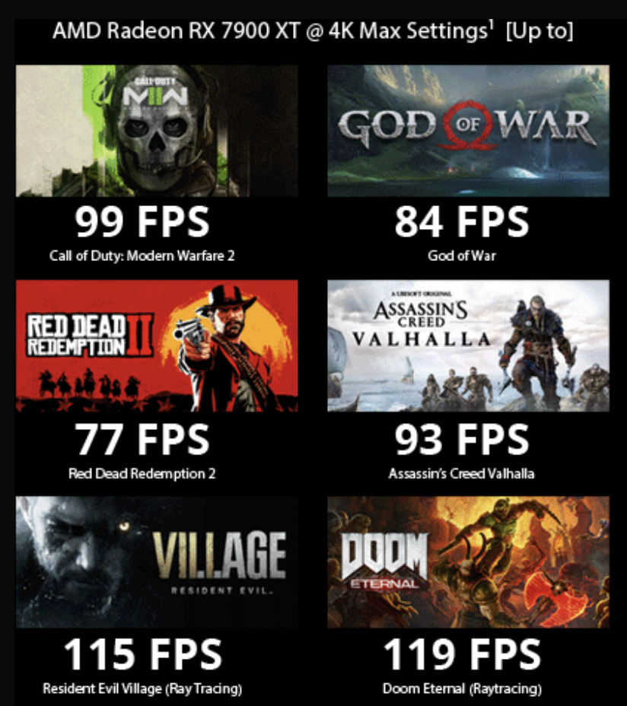
AMD Radeon RX 7900 XT Pros and Cons
Radeon™ RX 7900 Series graphics feature advanced AMD RDNA™ 3 compute units, with 2nd generation raytracing accelerators and new AI accelerators to deliver performance while maximizing graphical fidelity.
AMD Radeon RX 7900 XT Advantages
Almost twice as cheap as an RTX 4090
Capable of 144fps in most games at 1440p
Capable of over 60fps in most games at 4K
Smaller and less power hungry
AMD Radeon RX 7900 XT Disadvantage
Loud and overheat
Notes:
Radeon™ RX 7900 系列顯卡配備先進的 AMD RDNA™ 3 計算單元、第二代光線追踪加速器和全新 AI 加速器，可提供不錯的性能，同時最大限度地提高圖形保真度。
AMD Radeon RX 7900 XT 優勢
價格幾乎是 NVIDIA RTX 4090 的兩倍
在大多數 1440p 遊戲中能夠達到 144fps
在大多數 4K 遊戲中能夠達到 60fps 以上
更小、耗電更少
AMD Radeon RX 7900 XT 缺點
1. 多個用戶表示他們的 RX 7900 GPU 過熱，Radeon RX 7900 XT安裝在 21 攝氏度房間內，玩一小時後熱點溫度達到 77 攝氏度，峰值平均芯片溫度為 65 攝氏度。

Slide 10

Comparsion – NVIDIA v.s AMD GPU
GeForce GPU | GeForce RTX 4090 | GeForce RTX 3080 | GeForce RTX 2080 | GeForce GTX 1660 | Radeon RX 7900 XT | Radeon RX 6900 XT | AMD Radeon RX 5700 XT
GPU Engine Specification
NVIDIA ^{CUDA®} Cores | 16384 | 8960 / 8704 | 2944 | 1408 | - | - | -
Boost Clock(GHz) | 2.52 | 1.71 | 1.8 | 1.78 | 2.39 | 2.25 | 1.9
Basic Clock(GHz) | 2.23 | 1.26 / 1.44 | 1.52 | 1.53 | 1.50 | 1.8 | 1.6
Graphics Processor
Launch Price | 1,599 USD | 699 USD | 699 USD | 219 USD | 899 USD | 999 USD | 399 USD
Release Date | 2022/09/20 | 2020/09/01 | 2018/09/20 | 2019/03/14 | 2022/11/03 | 2020/10/28 | 2019/07/07
Architecture | Ada Lovelace | Ampere | Turing | Turing | RDNA 3.0 | RDNA 2.0 | RDNA 1.0
Chip factory | TSMC 4 nm | TSMC 8 nm | TSMC 12 nm | TSMC 12 nm | TSMC 5 nm | TSMC 7 nm | TSMC 7 nm
Transistor count | 76.3 billion | 28.3 billion | 13.6 billion | 6.6 billion | 57.7 billion | 26.8 billion | 10.3 billion
Chip area | 608mm² | 628mm² | 545mm² | 284mm² | 529mm² | 520mm² | 251mm²
Memory Specification
Standard Memory Settings | 24 GB GDDR6X | 12GB GDDR6X / 10GB GDDR6X | 8GB GDDR5 | 6GB GDDR5 | 20 GB GDDR6 | 16 GB GDDR6 | 8GB GDDR6
Memory Interface Bandwidth | 384 bits | 384 bit / 320 bit | 256 bits | 192 bits | 320 bits | 256 bit | 256 bits
Theoretical Performance
FP16 Performance | 82.58 TFLOPS | 29.77 TFLOPS | 20.14 TFLOPS | 10.05 TFLOPS | 103.0 TFLOPS | 46.08 TFLOPS | 19.51 TFLOPS
FP32 Performance | 82.58 TFLOPS | 29.77 TFLOPS | 10.07 TFLOPS | 5.027 TFLOPS | 51.48 TFLOPS | 23.04 TFLOPS | 9.754 TFLOPS
FP64 Performance | 1290 GFLOPS | 465.1 GFLOPS | 314.6 GFLOPS | 157.1 GFLOPS | 1.609 TFLOPS | 1440 GFLOPS | 609.6 GFLOPS
Board Design
Power consumption | 450W | 320W | 215W | 120W | 300 W | 300 W | 225 W
Power interface | 1x 16-pin | 1x 12-pin | 1x 6-pin + 1x 8-pin | 1x 8-pin | 2x 8-pin | 2x 8-pin | 1x 6-pin + 1x 8-pin
Notes:
TFLOPS 每秒浮點運算次數

Slide 11
3
NVIDIA / AMD Software support

Slide 12
NVIDIA / AMD Software support
Information from official website.
NVIDIA / AMD GPU | Architecture Name | DirectX® Version | OpenGL Version | OpenCL Version | Vulkan® Version | PCIe
NVIDIA RTX 40 Series | Ada Lovelace | DirectX® 12-2 | OpenGL 4.6 | OpenCL 3.0 | Vulkan® 1.3 | Gen 4
NVIDIA RTX 30 Series | Ampere | DirectX® 12-2 | OpenGL 4.6 | OpenCL 3.0 | Vulkan® 1.3 | Gen 4
NVIDIA RTX 20 Series | Turing | DirectX® 12-2 | OpenGL 4.6 | OpenCL 3.0 | Vulkan® 1.3 | Gen 3
NVIDIA GTX 16 Series | Turing | DirectX® 12-1 | OpenGL 4.6 | OpenCL 3.0 | Vulkan® 1.3 | Gen 3
NVIDIA GTX 10 Series | Pascal | DirectX® 12-1 | OpenGL 4.6 | OpenCL 3.0 | Vulkan® 1.3 | Gen 3
NVIDIA GTX 900 Series | Maxwell | DirectX® 11-1 | OpenGL 3.3 | OpenCL 1.1 | N/A | Gen 3
AMD Radeon™ RX 7900 | AMD RDNA™ 3 | DirectX® 12-2 | OpenGL 4.6 | OpenCL 2.2 | Vulkan® 1.3 | Gen 4
AMD Radeon™ RX 6900 | AMD RDNA™ 2 | DirectX® 12-2 | OpenGL 4.6 | OpenCL 2.1 | Vulkan® 1.3 | Gen 4
AMD Radeon™ RX 6800 | AMD RDNA™ 2 | DirectX® 12-2 | OpenGL 4.6 | OpenCL 2.1 | Vulkan® 1.3 | Gen 4

Slide 13
4
Compare Top Benchmarking Software

Slide 14
GPU Benchmarking Software
More information from: https://www.guru99.com/best-benchmark-software.html#7-novabench
Tool Name | Features | Platform | Price
AIDA64 Extreme | It offers more than 50 pages of information on installed programs, software licenses, etc. Supports multi-threaded memory and cache to analyze system RAM bandwidth. The information given by this software can be saved in CSV (Comma Separated Values), HTML, or XML formats. | Windows, iOS, and Android platforms | Free
PassMark | Allows you to run GPU performance tests directly from a USB drive. Test the speed of the 3D video card for free. You can measure the network speed between two computers using TCP/IP. | Windows and Android | Free
3DMark | Monitor GPU and CPU temperatures, clock speeds, and frame rate. Offers custom settings to benchmark according to your need. Two ways to test your device: a quick benchmark and a longer stress test. | Windows and Mac devices. | Basic: Free Advanced: $29.99 Professional: $1,495 per year
Geekbench | Game and image-processing test. Measure the multi-core and single-core power processor. | Windows, Linux, Mac, iOS, and Android | Free
Why we need to use Graphic Card Benchmark Software?
You can perform a cross API benchmark using OpenGL and Vulkan 2D and 3D graphics applications.
Test the performance of mobile and desktop PC.
Enables you to monitor GPU temperature.
Helps you to do software audits on installed software, program, security applications, and licenses.
It enables you to perform extreme hardware stability testing.
Notes:
基準測試軟件使您能夠了解GPU 中各種硬件組件的性能，例如RAM、GPU 週期、處理吞吐量等。許多此類應用程序使您能夠使用各種緩存選項、文件和塊大小來檢查磁盤的速度。
以下是使用顯卡基準測試軟件的重要原因：
您可以使用 OpenGL 和 Vulkan 2D 和 3D 圖形應用程序執行跨 AP​​I 基準測試。
測試移動和台式電腦的性能。
使您能夠監控 GPU 溫度。
幫助您對已安裝的軟件、程序、安全應用程序和許可證進行軟件審核。
它使您能夠執行極端的硬件穩定性測試。

Slide 15
5
Which GPU is the most cost-effective

Slide 16
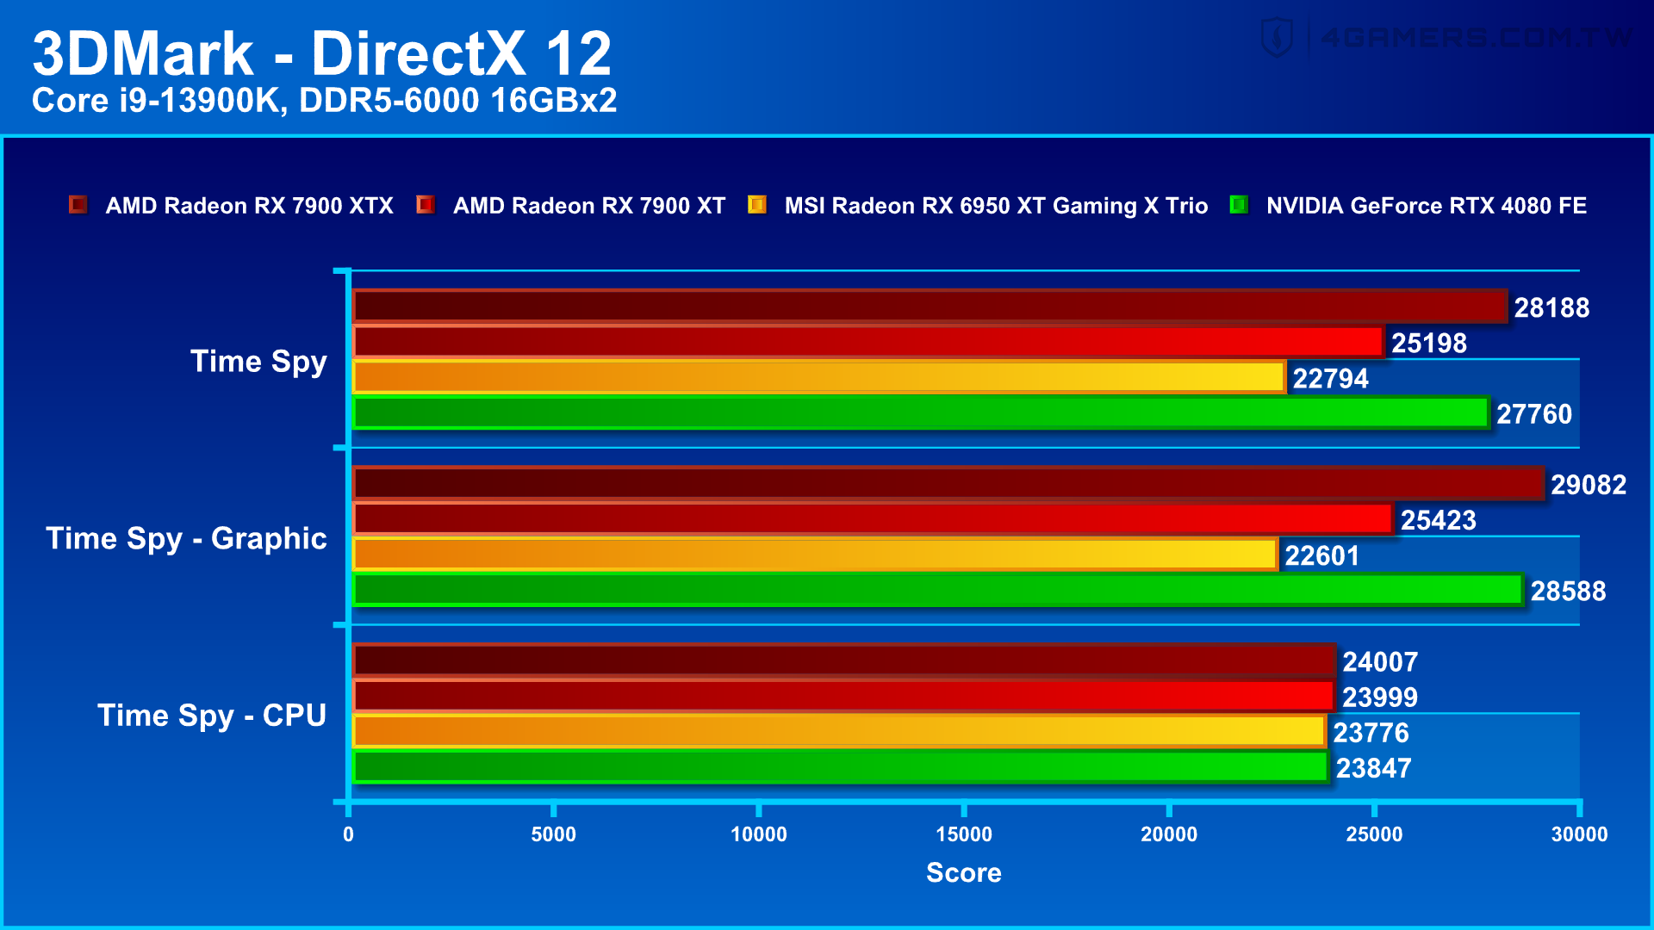
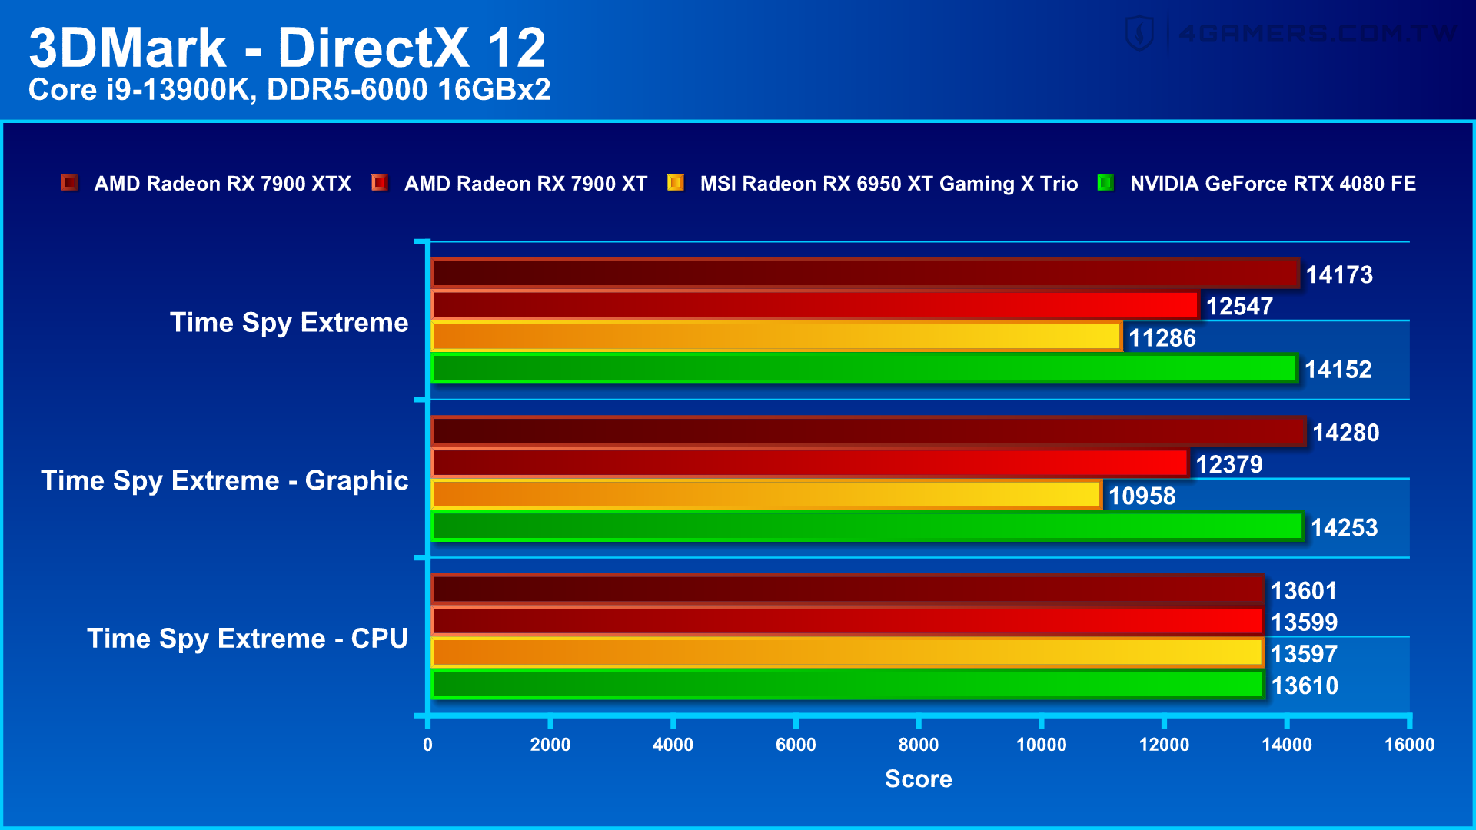
Time Spy
https://www.4gamers.com.tw/news/detail/56252/amd-radeon-rx-7900-xtx-and-rx-7900-xt-review
Time Spy 整個Time Spy Extreme可以分成3段測試，圖型測試1包含許多透明物件、粒子陰影（Particle Shadows）與曲面細分（Tessellation）。 圖型測試2則以數百道光源的體積光照（Volumetric Illumination）搭配大量粒子為測試項目。圖形測試3為處理器測試，與Time Spy測試相比，將運算需求量大幅提升至3倍，讓搭載先進指令集與8核心以上處理器能施展拳腳。
在模擬 DirectX 12 遊戲的 Time Spy 與 Time Spy Extreme 測試中，NVIDIA GeForce RTX 4080和AMD RX 7900 XTX 幾乎打成平手或險勝 1%，AMD RX 7900 XT 則落後 12% 上下。
Notes:
time spy extreme 是針對 4K 的畫面做的測試
整個Time Spy Extreme可以分成3段測試，圖型測試1包含許多透明物件、粒子陰影（Particle Shadows）與曲面細分（Tessellation）。圖型測試2則以數百道光源的體積光照（Volumetric Illumination）搭配大量粒子為測試項目。最後的處理器測試與Time Spy測試相比，將運算需求量大幅提升至3倍，讓搭載先進指令集與8核心以上處理器能施展拳腳。

Slide 17
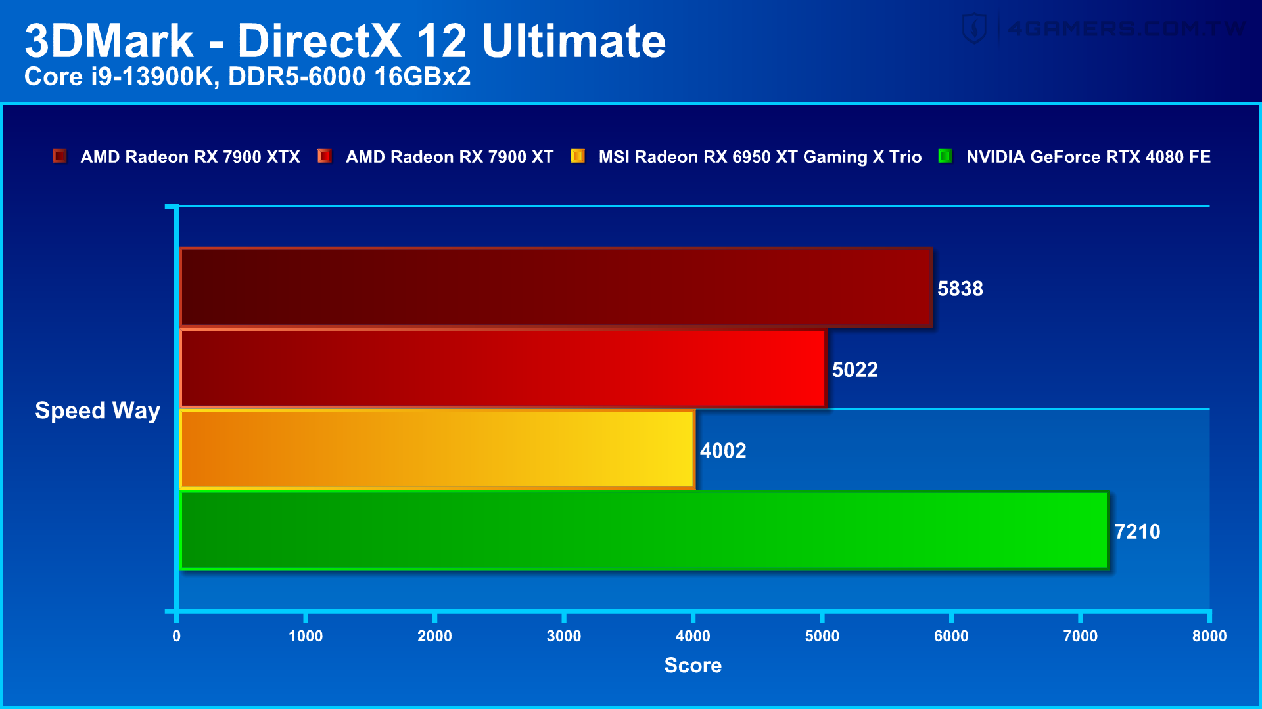

Speed Way
https://www.4gamers.com.tw/news/detail/56252/amd-radeon-rx-7900-xtx-and-rx-7900-xt-review
Speed Way納入包括光線追蹤、即時全局照明、網格著色與 VRR 等測試評估，所以 AMD RX 7900 XTX / AMD RX 7900 XT 相較 NVIDIA RTX 4080 達 20% 和 30%。

Slide 18
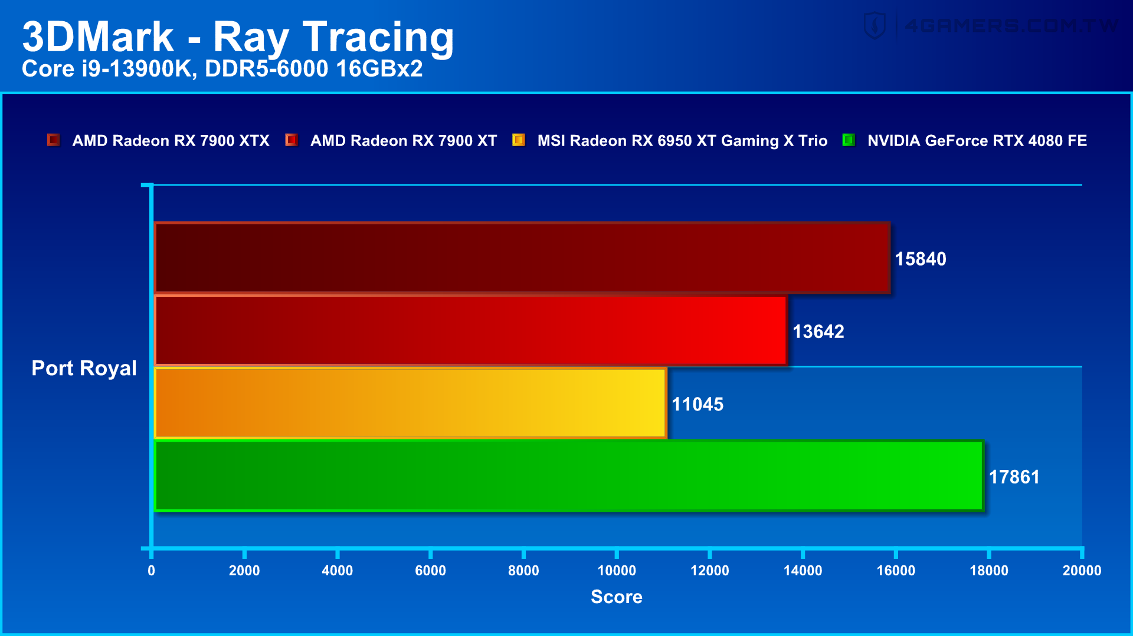
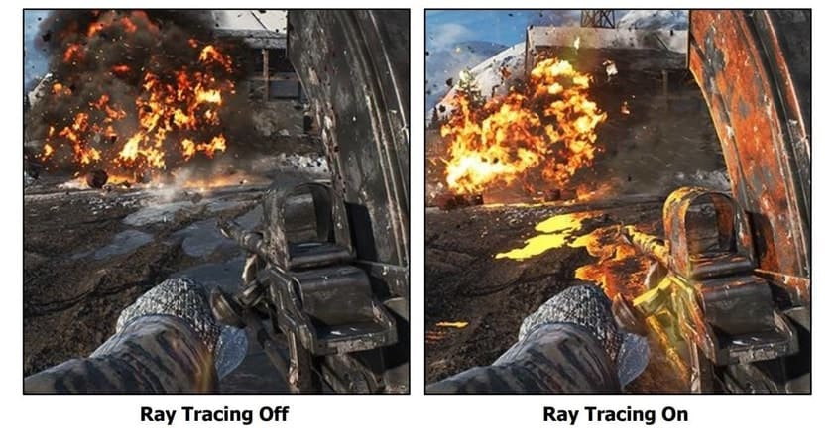
Ray Tracing – Port Royal
https://www.4gamers.com.tw/news/detail/56252/amd-radeon-rx-7900-xtx-and-rx-7900-xt-review
Port Royal 以2K 解析度進行測試，也就是1440p、2560x1440，利用光線追蹤技術運算物體表面反射以及物件的硬陰影，除此之外也包含bloom 光暈、DoF 場景深度、tone mapping 色調映射等後處理項目。
Port Royal 測試也是模擬光線追蹤遊戲，AMD RX 7900 XTX / AMD RX 7900 XT 落後NVIDIA RTX 4080 有 11% 和 24%。

Slide 19
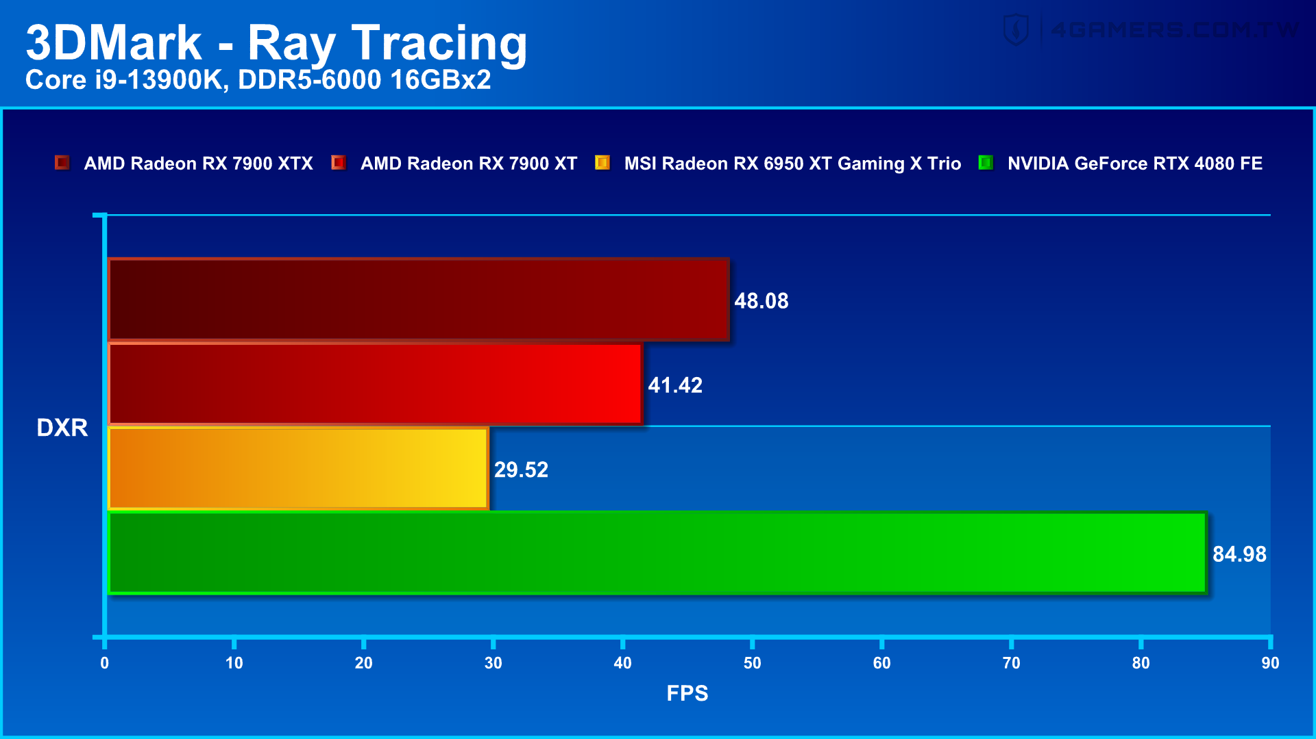
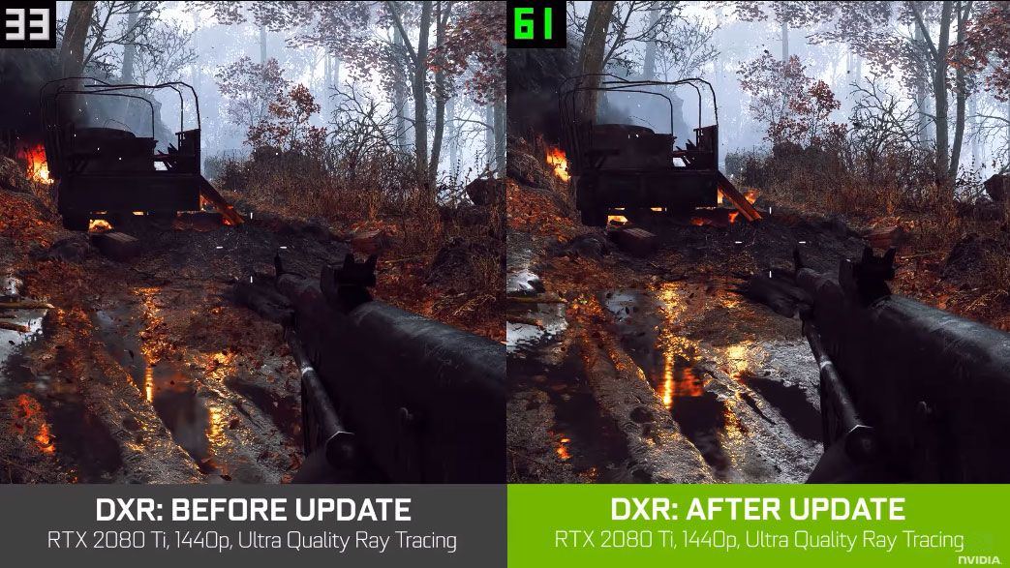
Ray Tracing – DXR
光線追踪（DXR）是微軟主導開發的一種光線計算特效，DXR指令集由4個概念部分構成：Acceleration Structure加速架構、遊戲引擎用的DispatchRays指令集、用於光線追蹤的HLSL Shader類別、Raytracing Pipeline State光線追蹤流水線。
DXR 測試，AMD RX 7900 XTX / AMD RX 7900 XT 較仍落後 NVIDIA RTX 4080 有 44% 和 52%。

Slide 20
Conclusion
Game Performance
In specific games, the AMD RX 7900 XTX can even lead the NVIDIA RTX 4080 by 15% to 20%. If the games you often play are listed, the AMD RX 7900 XTX actually has a pretty good price/performance ratio.
Radeon AMD RX 7900 XTX and RX 7900 XT are priced at US$ 999 / 899, compared to NVIDIA GeForce RTX 4090 priced at US$ 1,599, AMD RX series is easy to start.
Ray tracing is still AMD's weakness. If you are a fan of crazy lighting chase games, then the AMD RX 7900 series is not suitable for you.
Price
Ray Track
Power Consumption
NVIDIA RTX 4090 is more power consumption than AMD RX7900.
With AMD dramatically improving graphics card supply, and Nvidia's GTX 16-series parts now three years old, supply and availability can be a bit spotty.
Availability
Drivers and Software
Tie. One of the biggest differences between AMD and Nvidia drivers is Nvidia Control Panel handles things like resolution and certain graphics settings.
OVERALL
AMD clearly lags behind in ray tracing games, and DLSS 3 is still a factor. We can certainly see people willing to pay USD 600-700 more for an Nvidia graphics card.
Notes:
1. 在特定遊戲中，AMD RX 7900 XTX甚至可以領先NVIDIA RTX 4080 15%到20%。如果把你經常玩的遊戲都列出來的話，AMD RX 7900 XTX其實有著相當不錯的性價比。
2. PRICE:Radeon AMD RX 7900 XTX 和 RX 7900 XT 售價為 999 / 899 美元，相比 NVIDIA GeForce RTX 4090 售價 1599 美元，AMD RX 系列很容易入手。
3. RAY TRACK: 光線追踪仍然是AMD的弱點。如果你是瘋狂燈光追逐遊戲的粉絲，那麼AMD RX 7900系列不適合你。
4.
5. 供貨情況
6. 驅動程序和軟件
AMD 和 Nvidia 驅動程序之間的最大區別之一是 Nvidia 有兩個獨立的用戶界面。Nvidia 控制面板可處理分辨率和某些圖形設置等內容

Slide 21
References
https://blog.csdn.net/u014756627/article/details/129100476
https://blogs.nvidia.com/blog/2012/09/10/what-is-cuda-2/
https://www.51cto.com/article/755049.html
https://www.softwaretestinghelp.com/gpu-benchmark-software/
https://windows.atsit.in/bc/9830/
https://www.techpowerup.com/review/amd-radeon-rx-7900-xt/31.html
https://www.techspot.com/review/2589-amd-radeon-7900-xt/
https://www.topcpu.net/gpu-c/geforce-rtx-4080-vs-radeon-rx-7900-xt
https://news.xfastest.com/nvidia/129365/2023-gpu-report/
https://fc.bnext.com.tw/articles/view/2745?
https://www.mordorintelligence.com/industry-reports/global-gaming-market

Slide 22
Additional Information

Slide 23
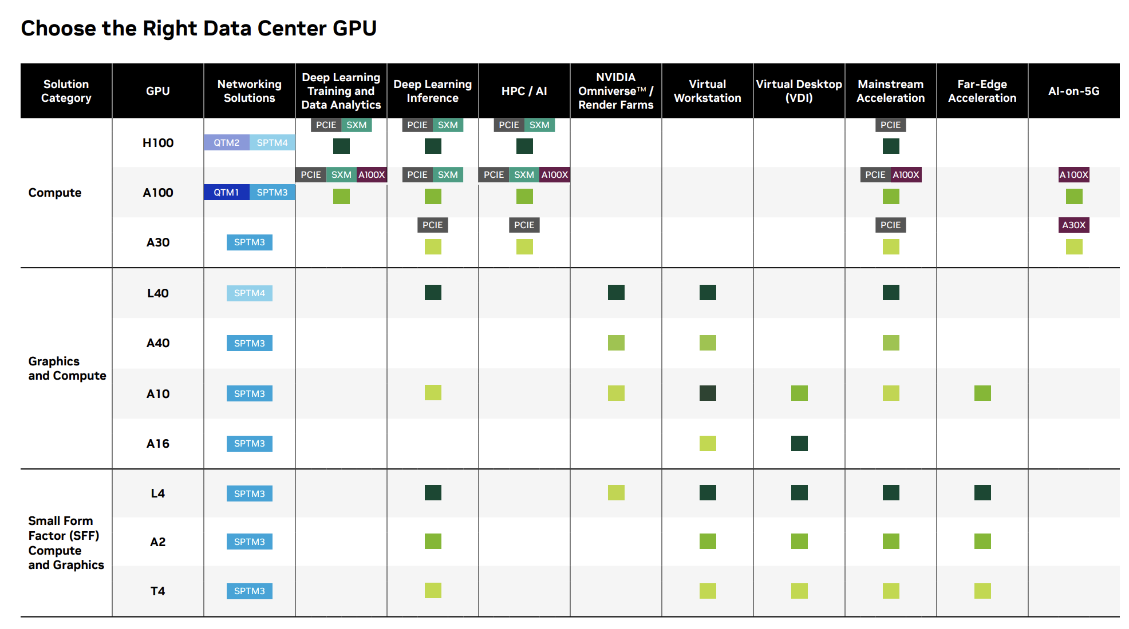
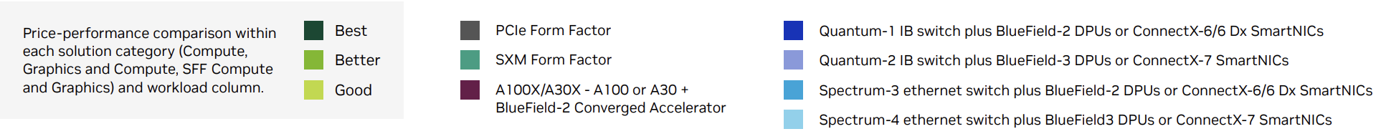
How to choose the right GPU

Slide 24
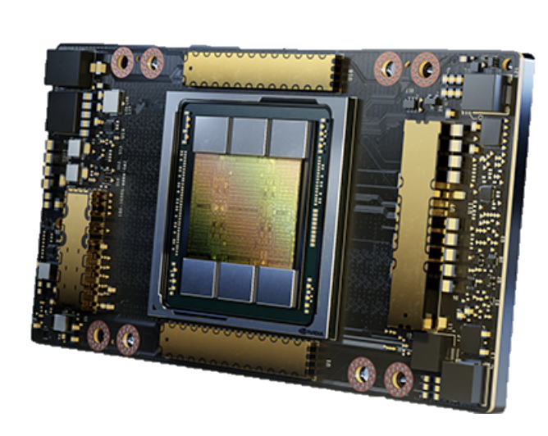
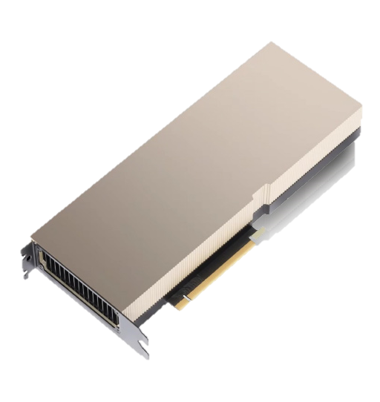
NVIDIA A100 GPU Key Feature
HPC, AI Inference, Data Analytics Applications
NVIDIA Ampere Architecture A100 can readily handle different-sized acceleration needs, from the smallest job to the biggest multi-node workload.
Third-Generation NVLink NVIDIA NVLink in A100 delivers 2X higher throughput compared to Tesla V100.
40 GB HBM2 and 40 MB L2 Cache NVIDIA A100 GPU has 40 GB of high-speed HBM2 memory with a class-leading 1555 GB/sec of memory bandwidth - 73% increase compared to Tesla V100.
NVIDIA A100 GPU
Multi-Instance GPU (MIG) The new Multi-Instance GPU (MIG) feature allows the A100 Tensor Core GPU to be securely partitioned into as many as seven separate GPU Instances for CUDA applications, providing multiple users with separate GPU resources to accelerate their applications and development projects.
PCIe Gen 4 with SR-IOV The faster speed is especially beneficial for A100 GPUs connecting to PCIe 4.0-capable CPUs, and to support fast network interfaces, such as 200 Gbit/sec InfiniBand.
Notes:
NVIDIA Ampere 架構： 無論是使用MIG 將A100 GPU 劃分為較小的實例，還是使用NVLink 連接多個GPU 以加速大規模工作負載，A100 都可以輕鬆處理不同規模的加速需求，從最小的作業到最大的多節點工作負載。A100 的多功能性意味著 IT 經理可以全天候最大限度地利用數據中心中每個 GPU 的效用。
第三代 Tensor 核心： NVIDIA A100 可提供 312 teraFLOPS (TFLOPS) 的深度學習性能。與 NVIDIA Volta GPU 相比，深度學習訓練的 Tensor 每秒浮點運算次數 (FLOPS) 是 20 倍，深度學習推理的每秒 Tensor 萬億次運算 (TOPS) 是 20 倍。
下一代 NVLink： A100 中的 NVIDIA NVLink 吞吐量比上一代提高 2 倍。與 NVIDIA NVSwitch™ 結合使用時，最多可將 16 個 A100 GPU 以高達 600 GB/秒 (GB/秒) 的速度互連，從而在單個服務器上釋放出最高的應用程序性能。NVLink 可通過 HGX A100 服務器主板在 A100 SXM GPU 中使用，並可通過最多 2 個 GPU 的 NVLink 橋在 PCIe GPU 中使用。
多實例 GPU (MIG)： A100 GPU 可以分為多達 7 個 GPU 實例，這些實例在硬件級別上完全隔離，具有自己的高帶寬內存、緩存和計算核心。MIG 使開發人員能夠為其所有應用程序實現突破性的加速，而 IT 管理員可以為每項作業提供適當大小的 GPU 加速，從而優化利用率並擴展對每個用戶和應用程序的訪問。
高帶寬內存（HBM2E）： 憑藉高達 80 GB 的 HBM2e，A100 提供超過 2TB/s 的全球最快 GPU 內存帶寬，以及高達 95% 的動態隨機存取內存（DRAM）利用率。A100 的內存帶寬比上一代高出 1.7 倍。

Slide 25
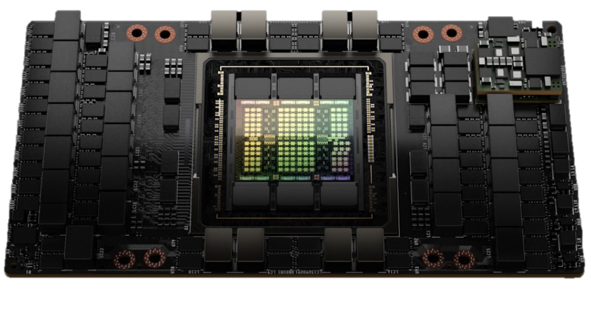
NVIDIA H100 GPU Key Feature
Fourth-generation NVIDIA NVLink® H100 provides a 3x bandwidth increase on all-reduce operations and a 50% general bandwidth increase over the prior generation NVLink with 900 GB/sec total bandwidth for multi-GPU IO operating at 7x the bandwidth of PCIe Gen 5.
Transformer Engine H100 manages and dynamically chooses between FP8 and 16-bit calculations, automatically handling re-casting and scaling between FP8 and 16-bit in each layer to deliver up to 9x faster AI training and up to 30x faster AI inference speedups on large language models compared to the prior generation A100.
PCIe Gen 5L H100 provides 128 GB/sec total bandwidth (64 GB/sec in each direction) compared to 64 GB/sec total bandwidth (32GB/sec in each direction) in Gen 4 PCIe.
Second-generation Multi-Instance GPU (MIG) H100 provides approximately 3x more compute capacity and nearly 2x more memory bandwidth per GPU Instance compared to A100.
NVIDIA H100 GPU on new SXM5 Model
New DPX Instructions H100 accelerate Dynamic Programming algorithms by up to 7x over the A100 GPU.
New Confidential Computing H100 support protects user data, defends against hardware and software attacks, and better isolates and protects VMs from each other in virtualized and MIG environments.

Slide 26
Comparsion - NVIDIA
More information please see excel.
Data Center GPU | NVIDIA Tesla V100 | NVIDIA A100 | NVIDIA H100
GPU Architecture | Volta | Ampere | Hopper
Computer Capability | 7.0 | 8.0 | 9.0
Price | N/A | 8,000-9,000/USD | 10,000/USD
Process Size | 12 nm | 7 nm | 4 nm
Density | 25.9M / mm² | 65.6M / mm² | 98.3M / mm²
Die Size | 815 mm² | 826 mm² | 814 mm²
Highest Power Consumption | 250-300 W | 300 W | 350 W
Threads/Wrap | 32 | 32 | 32
Max Warps/SM | 64 | 64 | 64
Max Threads/SM | 2048 | 2048 | 2048
Max Thread Blocks (CTAs)/SM | 32 | 32 | 32
Max 32-bits Registers/SM | 65536 | 65536 | 65536
Max Registers/Thread Block (CTA) | 65536 | 65536 | 65536
Max Registers/Thread | 255 | 255 | 255
Max Thread Block Size | 1024 | 1024 | 1024
FP32 Cores/SM | 64 | 64 | 128
Ratio of SM Registers to FP32 Cores | 1024 | 1024 | 512
Shared Memory Size / SM | Configurable up to 96 KB | Configurable up to 164 KB | Configurable up to 228 KB
Which GPU is right for you?
The A100 is a more powerful GPU ideal for intensive AI tasks such as deep learning, simulation, and analytics. If you plan on using your GPU for machine learning or big data processing, the A100 is the way to go. On the other hand, the H100 is more suitable for graphics-intensive tasks like gaming and professional graphics work. It’s also more affordable and offers good value for money.

Slide 27
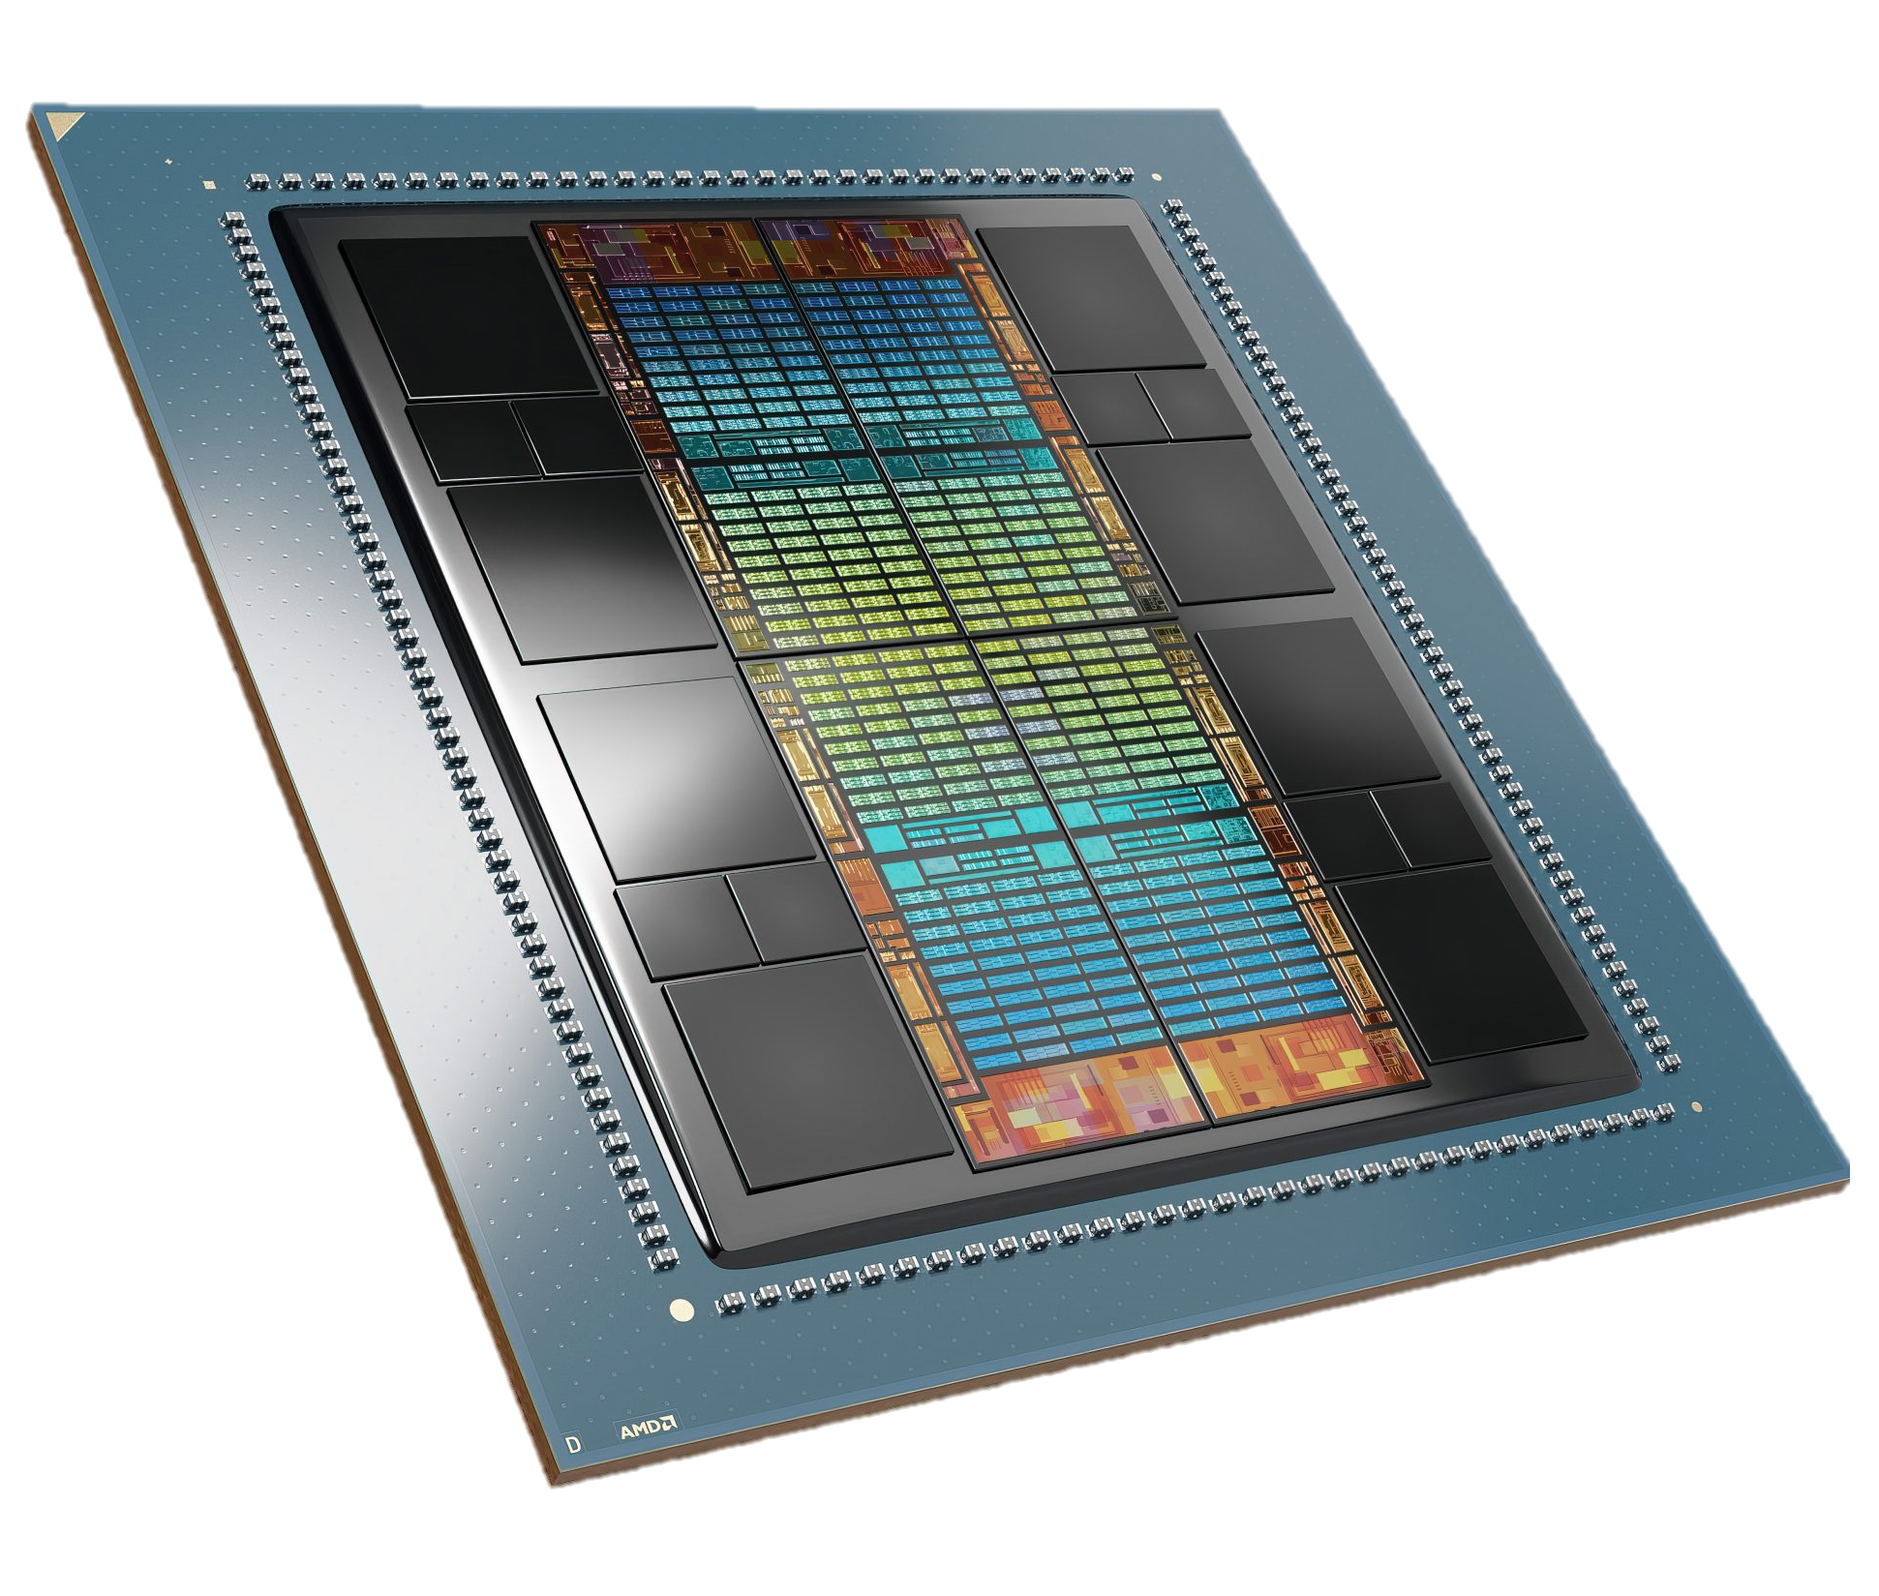
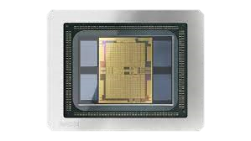
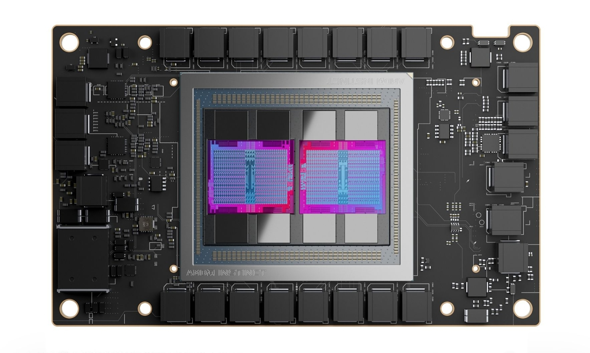
AMD GPU Acceleration
AMD INSTINCT™ MI100
AMD INSTINCT™ MI120
AMD INSTINCT™ MI300
2020
AMD CONA ™
Ecosystem Growth
AMD CONA ™ 2
Driving HPC and AI to New Frontier
AMD CONA ™ 3
Data Center APU
2023
First purpose-built GPU architecture for the data center.
First multi-die data center GPU expands scientific discovery and brings choice to AI training.
Breakthrough architecture designed for leadership efficiency and performance for HPC and AI.
Notes:
MI300 將提供 APU 產品，結合 AMD Zen 4 架構與 RDNA 3 GPU ，強調是市場上首款資料中心級的 APU 產品

Slide 28
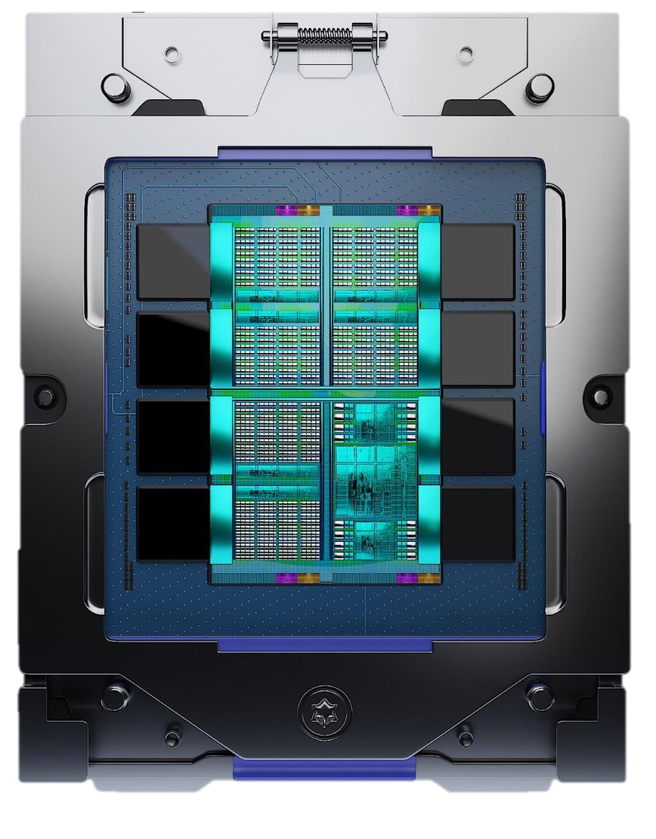
AMD INSTINCT™ MI300 GPU Key Feature
AMD Instinct MI300 is expected to ramp up in Q4 of 2023
Groundbreaking 3D Packaging： CPU, GPU, Cache, HBM
Designed for Leadership Memory Bandwidth and Application Latency.
APU Architecture Designed for Power Savings Compared to Discrete Implementation.
4th Gen AMD Infinity Architecture： AMD CONA™ 3 and EPYC ™ CPU ZEN 4 Together. CPU and GPU cores share a unified on-package pool of memory.
AMD INSTINCT™ MI300
Notes:
1. CPU 與 GPU 之間採用第四代 Infinity 架構連接，實現統一記憶體架構
2. Intsinct MI300 將採用 3D 封裝
4. 強調是市場上首款資料中心級的 APU 產品

Slide 29
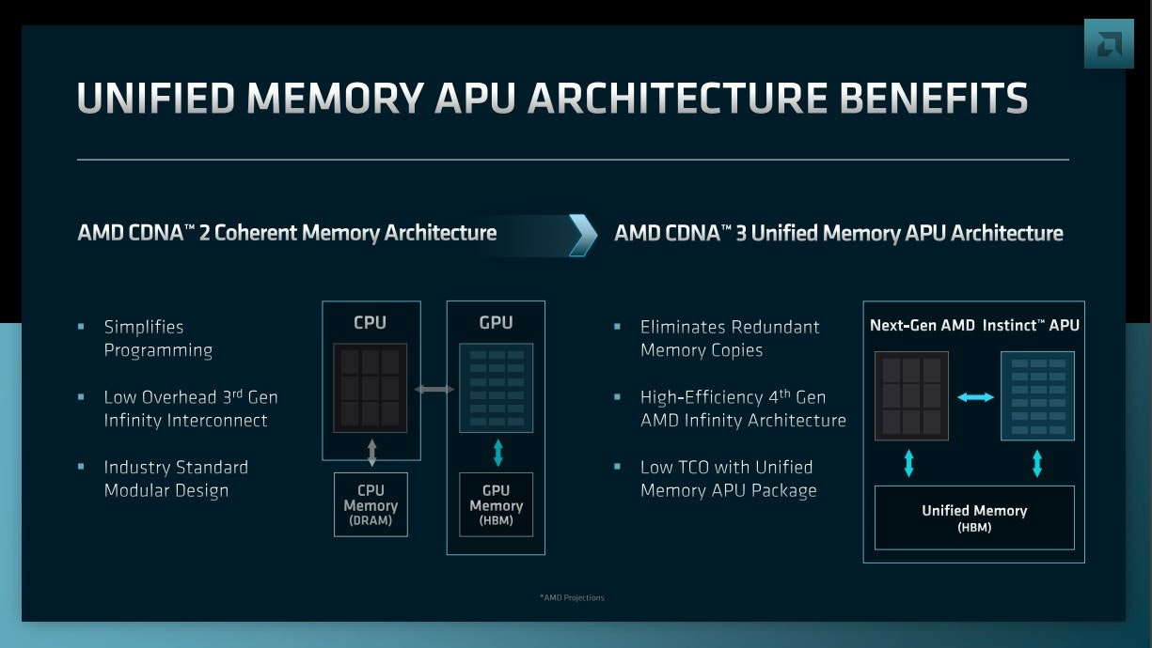
AMD INSTINCT™ MI300 GPU Key Feature
AMD CONA™ 2 Coherent Memory Architecture
AMD CONA™ 3 Unified Memory APU Architecture
Eliminates Redundant Memory Copies
High-efficiency 4th Gen AMD Infinity Architecture
Low TCO with Unified Memory APU Package
Simplifies Programming
Low overhead 3rd Gen Infinity Interconnect
Industry Standard Modular Design
Notes:
MI300 APU 對 AMD 是突破性的產品設計，不僅使用 Zen 4 CPU 與 CDNA 3 GPU 以 5nm 製程組成，更重要的是由於 CDNA 3 架構導入 UMAA 技術，使得 Instinct MI300 APU 具備統一記憶體儲存架構，使 CPU 與 GPU 之間不再需要配置獨立記憶體，使用單一大容量 HBM 記憶體供 CPU 與 GPU 直接存取，此外借助新架構， CDNA 3 還將比起 CDNA 2 提升 5 倍每瓦效能，同時相較 Instinct MI250X 加速器， AI 效能將一舉提升 8 倍。

Slide 30
Comparsion - AMD INSTINCT™
More information please see excel.
Data Center GPU | MI210 | MI250 | MI250X | MI300
Compute units | 104 CU | 208 CU | 220 CU | 304 CU
Stream processors | 6,656 | 13,312 | 14,080 | 14,080
Peak FP64/FP32 Vector | 22.6 TFLOPS | 45.3 TFLOPS | 47.9 TFLOPS | 47.87 TFLOPS
Peak FP64/FP32 Matrix | 45.3 TFLOPS | 90.5 TFLOPS | 95.7 TFLOPS | N/A
Peak FP16/BF16 | 181.0 TFLOPS | 362.1 TFLOPS | 383.0 TFLOPS | 383.0 TFLOPS
Peak INT4/INT8 | 181.0 TOPS | 362.1 TOPS | 383.0 TOPS | 383.0 TOPS
Memory size | 64 GB HBM2e | 128 GB HBM2e | 128 GB HBM2e | 128 GB HBM3
Memory Interface | 4,096 bits | 8,192 bits | 8,192 bits | 8,192 bits
Memory clock | 1.6 GHz | 1.6 GHz | 1.6 GHz | 1.6 GHz
Memory bandwidth | Up to 1.6 TB/s | Up to 3.2 TB/s | Up to 3.2 TB/s | Up to 3.2 TB/s
Infinity Fabric Links | Up to 3 | Up to 6 | Up to 8 | Up to 8
Coherency Enabled | Yes | No | Yes | N/A
OS support | Linux 64 bit | Linux 64 bit | Linux 64 bit | N/A
Thermal | Passively cooled | Passive & Liquid | Passive & Liquid | Passive & Liquid
Price | 16,000/USD | 14,500/USD | 14,500/USD | 29,000/USD
Process Size | 6 nm | 6 nm | 6 nm | 5 nm
Density | 80.4M / mm² | 80.4M / mm² | 80.4M / mm² | 143.6M / mm²
Die Size | 724 mm² | 724 mm² | 724 mm² | 1,017 mm²
Max power | 300 W | 500 & 560W | 500 & 560W | 600 W
Bus interface | PCIe Gen 3, 4 support | PCIe Gen 4 support |  | PCIe 4.0 x16

Slide 31
Comparison – NVIDIA & AMD GPU
Specification | NVIDIA A100 | NVIDIA H100 | AMD Instinct™ MI210 | AMD Instinct™ MI250X | AMD Instinct™ MI300
Launched | 2020/6/22 | 2022/3/22 | 2021/3/22 | 2021/11/8 | 2023/1/4
Typical Workload | Datacenter Servers, Edge | Datacenter Servers | Datacenter Servers | Datacenter Servers | Datacenter Servers
Price | 8,000-9,000/USD | 10,000/USD | 16,000/USD | 14,500/USD | 29,000/USD
Process Size | 7 nm | 4 nm | 6 nm | 6 nm | 5 nm
Density | 65.6M / mm² | 98.3M / mm² | 80.4M / mm² | 80.4M / mm² | 143.6M / mm²
Die Size | 826 mm² | 814 mm² | 724 mm² | 724 mm² | 1,017 mm²
Max power | 300 W | 350 W | 300W | 500W - 560W | 600 W
Thermal | Passive | Passive | Passive | Passive & Liquid | Passive & Liquid
GPU clocks | Base: 1,065 MHz Boost: 1,410 MHz | Base: 1,125 MHz Boost: 1,755 MHz | Base: 1,000 MHz Boost: 1,700 MHz | Base: 1,000 MHz Boost: 1,700 MHz | Base: 1,000 MHz Boost: 1,700 MHz
PCI Express | PCI Express 4.0 ×16 | PCI Express Gen4, 5 | PCI Express 4.0 ×16 | PCI Express 4.0 ×16 | PCI Express 4.0 ×16
Memory clock | 1,512 MHz | 1,593 MHz | 1.6 GHz | 1.6 GHz | 1.6 GHz
Memory type | HBM2e | HBM2e | HBM2e | HBM2e | HBM3
Memory size | 80 GB | 80 GB | 64 GB | 128 GB | 128 GB
Memory bus width | 5,120 bits | 5,120 bits | 4,096 bits | 8,192 bits | 4,096 bits
Peak memory bandwidth | Up to 1.94 TB/sec | Up to 2 TB/sec | Up to 1.6 TB/sec | Up to 3.2 TB/s | up to 1.6 TB/s

Slide 32
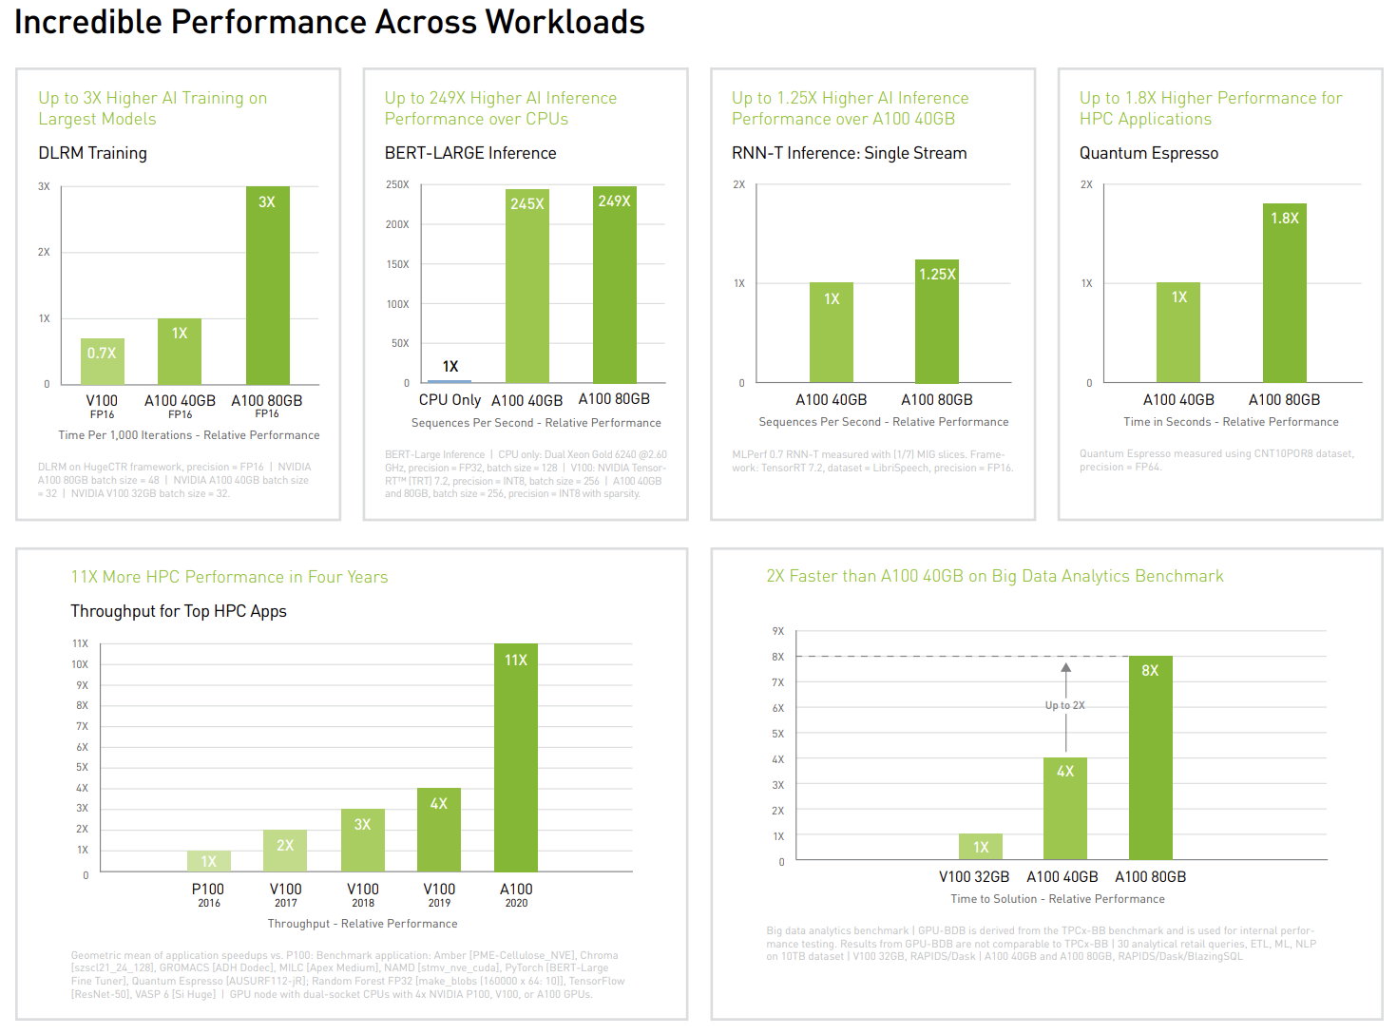
NVIDIA A100 Breakthroughs
A100 provides up to 20X higher performance over the prior NVIDIA Volta™ generation. A100 can efficiently scale up or be partitioned into seven isolated GPU instances with Multi-Instance GPU (MIG), providing a unified platform that enables elastic data centers to dynamically adjust to shifting workload demands.
The latest generation A100 80GB doubles GPU memory and debuts the world’s fastest memory bandwidth at 2 terabytes per second (TB/s), speeding time to solution for the largest models and most massive datasets.

Slide 33
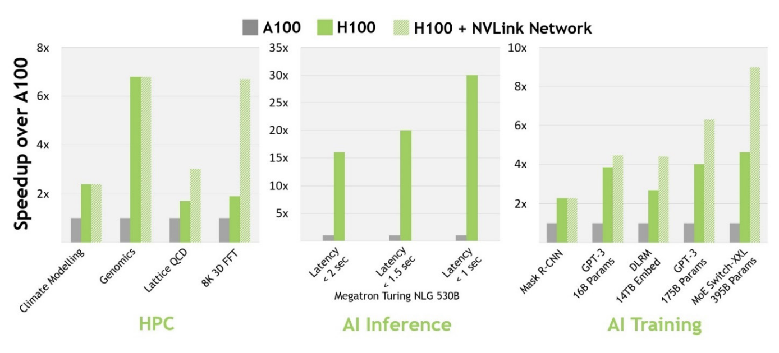
NVIDIA H100 Breakthroughs(1)
H100 with InfiniBand interconnect delivers up to 30 times the performance of A100. With the new NVLink Switch System interconnect targeted at some of the largest and most challenging computing workloads that require model parallelism across multiple GPU-accelerated nodes to fit, these workloads receive yet another generational performance leap, in some cases tripling performance yet again over H100 with InfiniBand.
▲ H100 Enables Next-Generation AI and HPC Breakthroughs

Slide 34
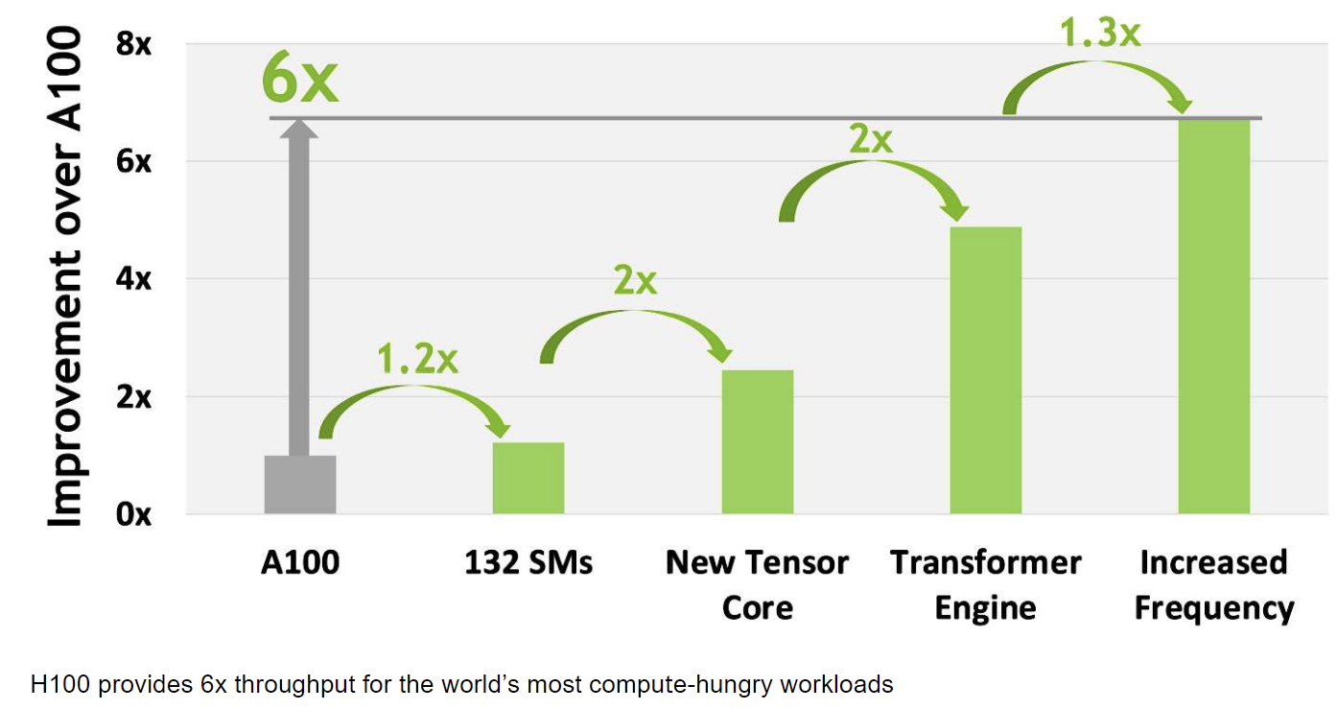
NVIDIA H100 Breakthroughs(2)
Overall, H100 provides approximately 6x compute performance improvement over A100 when factoring in all the new compute technology advances in H100.
Figure 2 summarizes the improvements in H100 in a cascading manner, starting with its 132 SMs providing a 22% SM count increase over A100’s 108 SMs. Each of the H100 SMs is 2x faster thanks to its new 4th Generation Tensor Core.
And within each Tensor Core, the new FP8 format and associated Transformer Engine provide another 2x improvement. Finally, increased clock frequencies in H100 deliver another approximately 1.3x performance improvement.
▲ H100 compute improvement summary

Slide 35
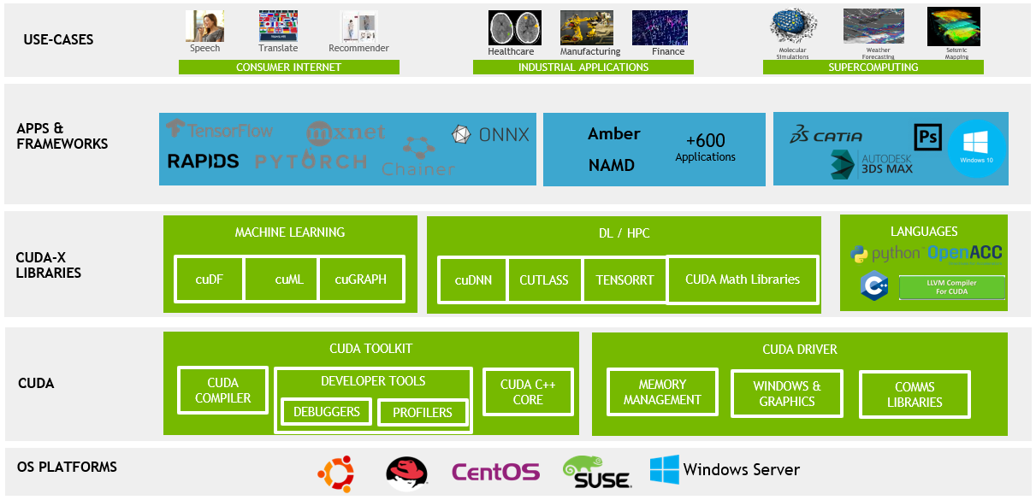
NVIDIA CUDA platform and its ecosystem
It is a software and hardware integration technology launched by NVIDIA, which is the company's official name for GPGPU. Through this technology, users can use NVIDIA's GPU for calculations other than image processing. It is also the first time that GPU can be used as a development environment for C-compilers.

Slide 36
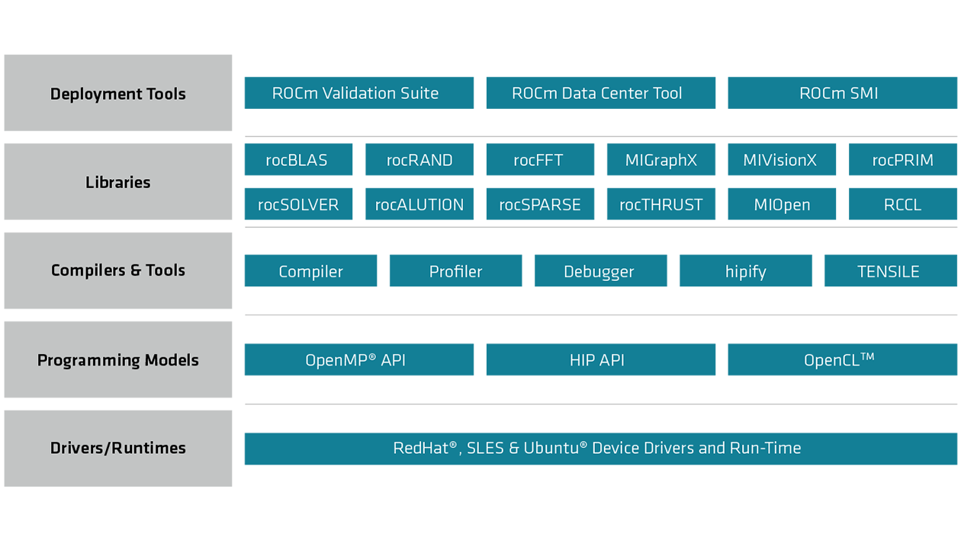
AMD ROCm platform and its ecosystem
ROCm supports HIP and OpenCL two GPU programming models, which can realize the migration from CUDA to ROCm. The latest ROCm 5.0 supports AI framework containers on AMD Infinity Hub, including TensorFlow 1.x, PyTorch 1.8, MXNet, etc., while improving the performance and stability of ROCm libraries and tools, including MIOpen, MIVisionX, rocBLAS, rocFFT, rocRAND.

Slide 37


Comparison CUDA and ROCm
Application
HPC
AI
HPC
AI
Development
Tools
NVIDIA GCDM
CNVIDIA Nsight
ROCm SMI
ROCm Vaildation Suite
ROCm Data Center Tools
MATH
cuBLAS
cuFFT
cuRAND
cuSOLVER
AI
cuDNN
DeepStream
DALI
VIDEO
nvJPEG
Code SDK
Parallel
Thrust
COMMU
NVSHMEM
NCCL
MATH
rocBLAS
rocFFT
rocRAND
rocSOLVER
AI
MIOpen
MIGrahX
MIVisionX
COMMU
RCCL
PARALLEL
rocTHRUST
Libraries
Compiler Tools
Compiler
Profiler
Debugger
Compiler
Profiler
Debugger
HIPTools
Programming models
CUDA
OpenCL
OpenACC
HIP
OpenMP
OpenCL
Driver & Runtime
NVIDIA Driver& CUDA Runtime
AMD Driver& ROCm Runtime
Hardware
NVIDIA GPU
AMD Radeon GPU

Slide 38


